Slide 1

Clearing the Fog! Getting Started on Cumulus:
a Near to the Ground On Campus Cloud Solution

Slide 2
Getting Started on CUmulus
Gerardo Hidalgo-Cuellar
www.rc.colorado.edu
rc-help@colorado.edu
Slides and tutorial: https://github.com/ResearchComputing/CUmulus_tutorials
Survey at: http://tinyurl.com/curc-survey18

Slide 3
Learning Objectives
Logging into CUmulus via Horizon (the CUmulus web portal)
Creating your instance (i.e. virtual machine)
Logging into your instance via ssh

Slide 4
Outline
What is CUmulus?
CUmulus Access
Access to CUmulus and the allocation process
Logging into Horizon (CUmulus web portal)
Creation of an instance
Logging into your instance
Demo workflow one might use on CUmulus:
Web App & Database
CUmulus + CURC HPC Integration

Slide 5
What is CUmulus?
CUmulus is CU Research Computing's free-to-use on-premise cloud service.
Supports cases not well-suited for HPC such as
research-oriented web servers
databases
long-running services
Provides users with persistent or ongoing availability by allocating them a logically isolated section of the cloud.

Slide 6
What is CUmulus?
You get your own virtual “world” for experimentation - an environment that can be easily created/deleted.
Install Software
Administer your instance (you’re in control!)
Run applications and jobs
Interface w/ other CURC services: Blanca, Alpine, PetaLibrary
You can request specific resources (CPU, storage, memory) and can set up persistent storage.

Slide 7
CUmulus Access

Slide 8
CUmulus Access and Allocation
Users will submit a proposal for your use case (email rc-help@colorado.edu):
Describe your CUmulus workflow
Describe why your workflow is appropriate for CUmulus
Estimate the resources you require:
operating system, CPU cores, disk space, memory
This is an iterative process where we work with you to make sure the request for resources fits your (and our) needs.
Learn more about the allocation request process at https://www.colorado.edu/rc/userservices/allocations

Slide 9
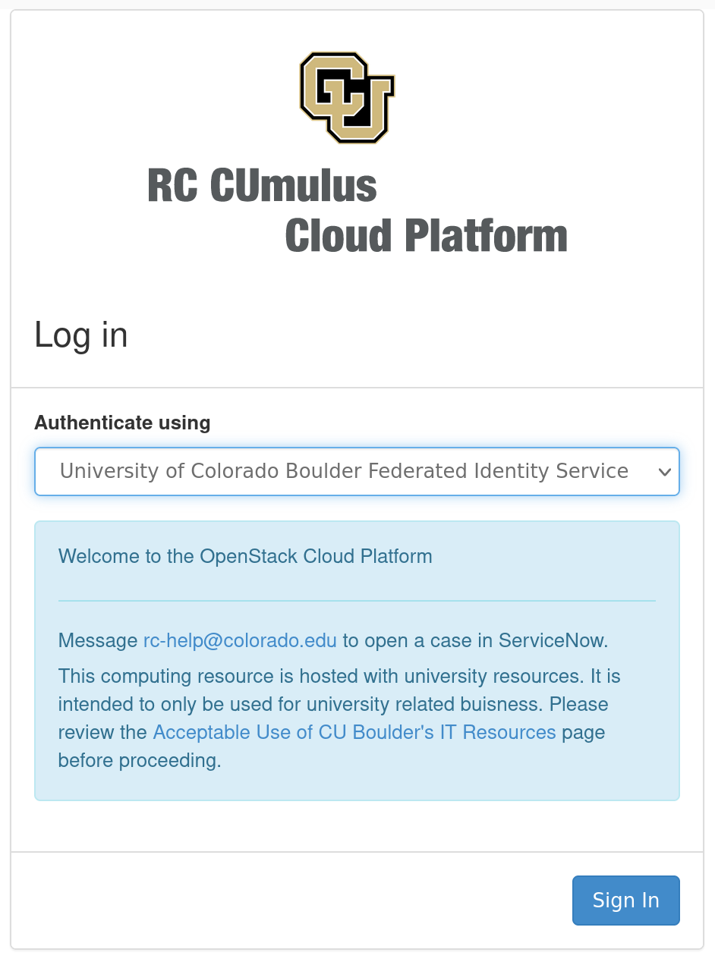
Log in to Horizon
Horizon is the CUmulus web portal
cumulus.rc.colorado.edu/
Let’s take a brief tour of Horizon
Log in with your institution’s credentials:

Slide 10
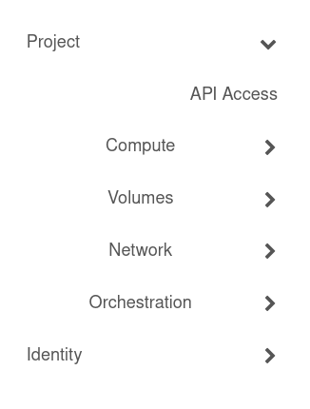
Navigate Horizon
Choose your project (top left)
Generally users only have 1 project
4 main sections
Compute
Volumes
Networks
Orchestration

Slide 11
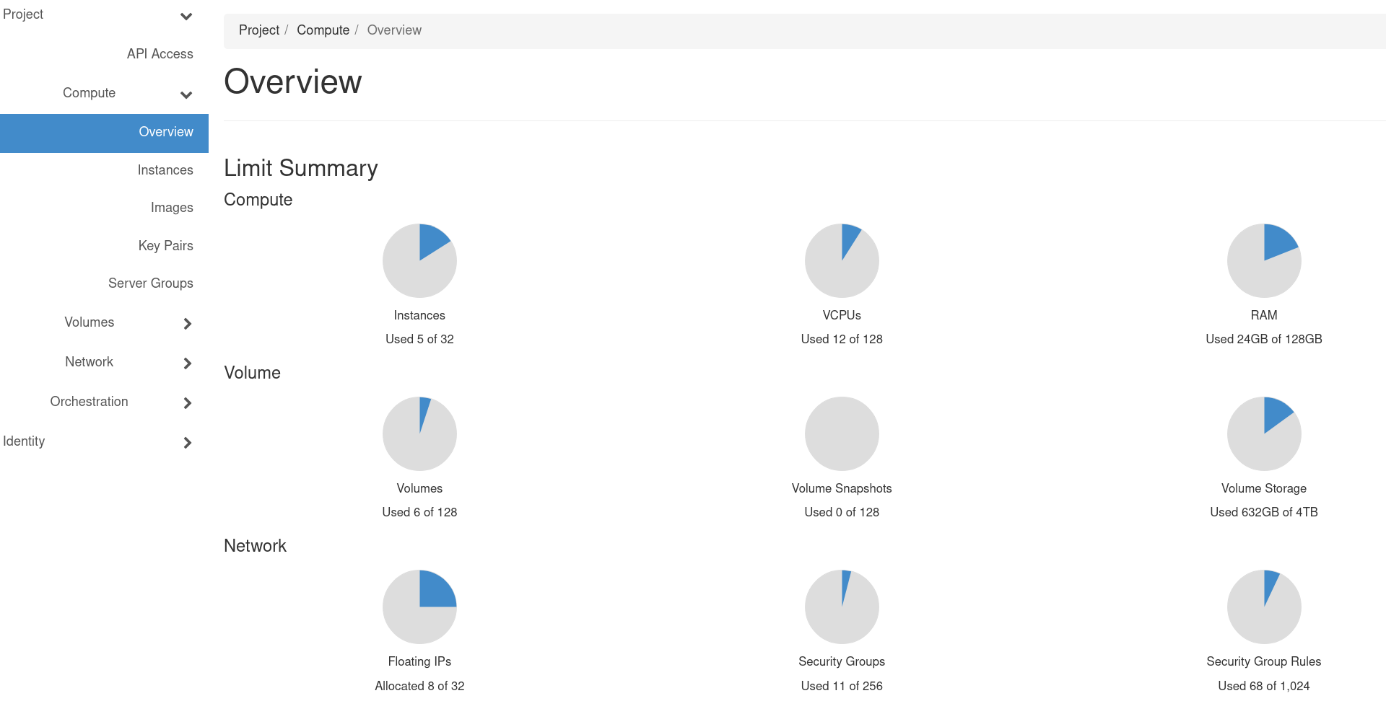
Navigate Horizon: Overview
Land on the Overview page under “Compute”
quick summary of your project

Slide 12
Navigate Horizon: Instances
Navigate to:
Project->Compute->Instances
Instances are virtual machines that run inside the cloud, more simply: an instance is just a digital version of a physical computer.
Instances can perform almost all of the same functions as a computer, including running applications and operating systems.

Slide 13
Instance Creation

Slide 14
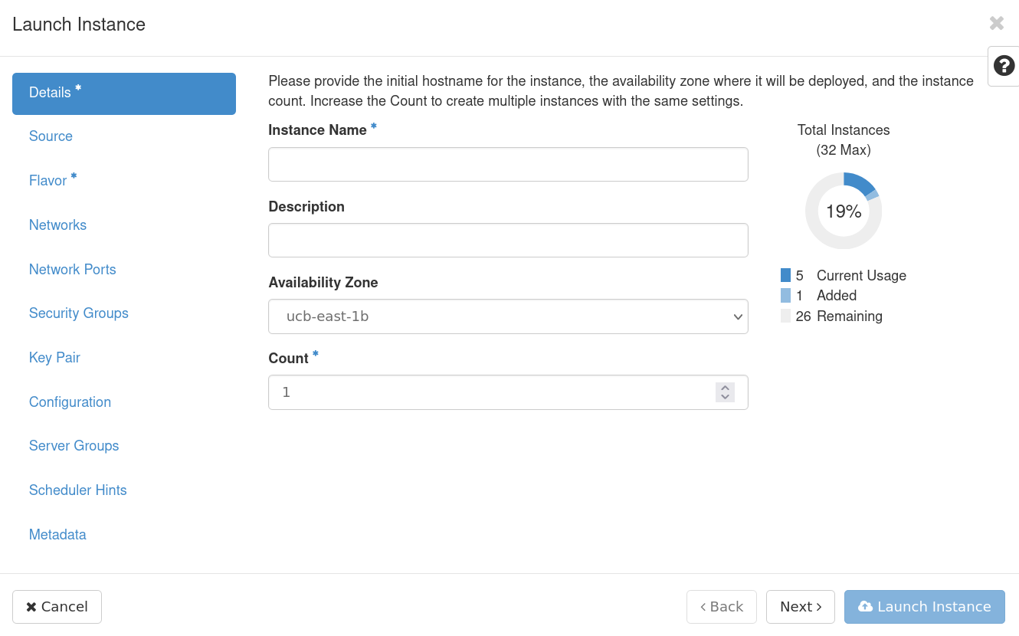
Let’s create a simple instance together
From the instances page click on “Launch Instance”
The Instance Creation Launcher will pop up giving us options to create our virtual machine:

Slide 15
Details
Fill out Instance details, including a name and description
availability zone and count can be left as defaults

Slide 16
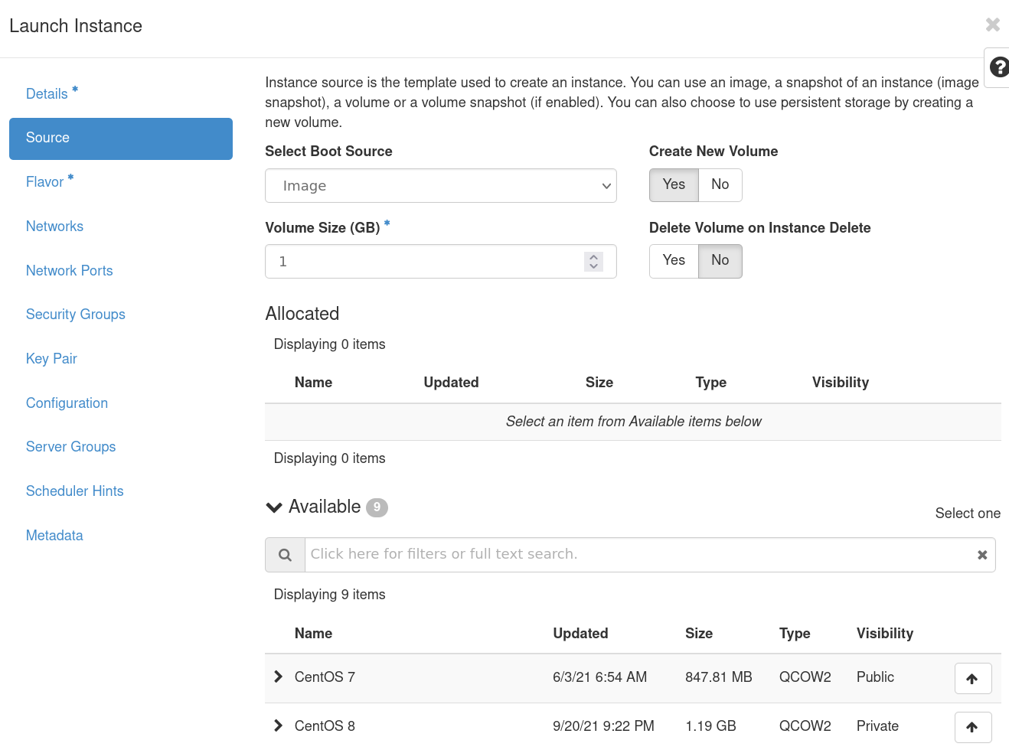
Source
You can choose an operating system from the images CURC provides
Choose to have your storage volume deleted on Instance Deletion
If you select fno” be aware of “zombie” volumes that will stay around when the instance is deleted

Slide 17
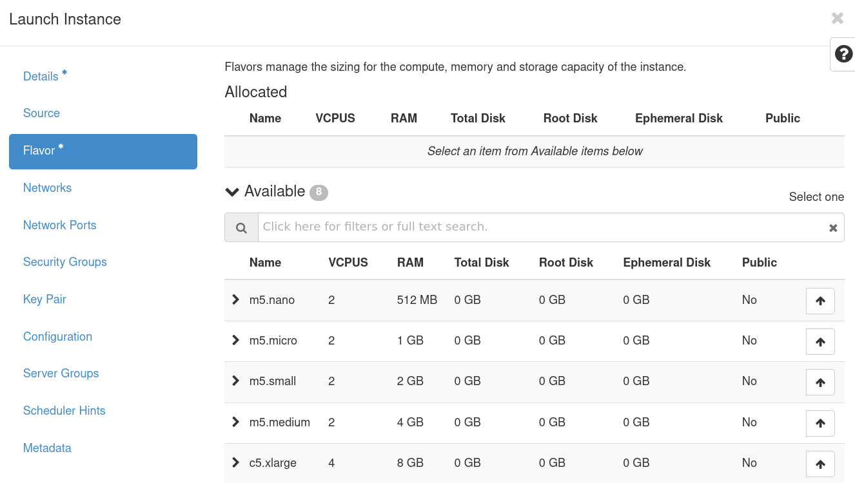
Flavor
Choose from a list of pre-selected resources:
A flavor defines the compute, memory, and storage capacity of our instance.

Slide 18
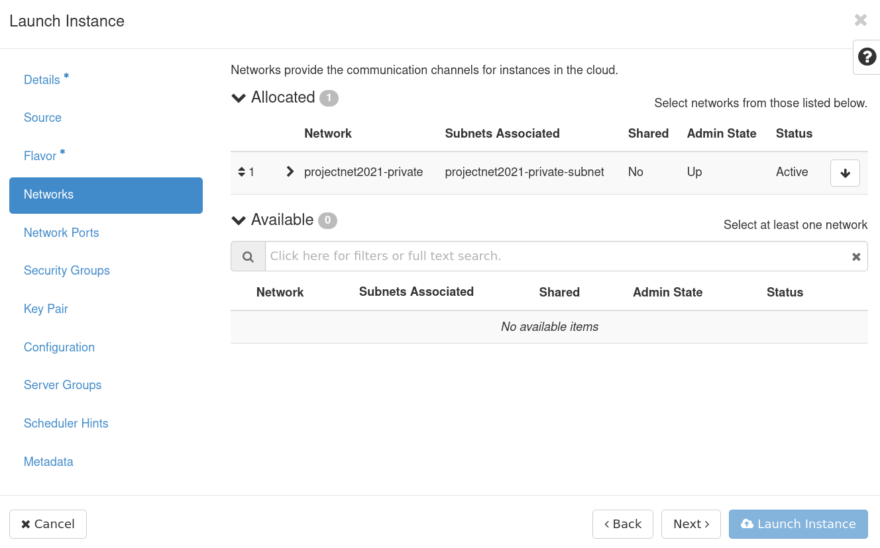
Networks & Network Ports
Select a project network, which determines routability of either a public/internet or campus/internal floating IP.
We’ll choose an external network
Ports provide extra communication channels to your instances.
You can select ports instead of networks or a mix of both.

Slide 19
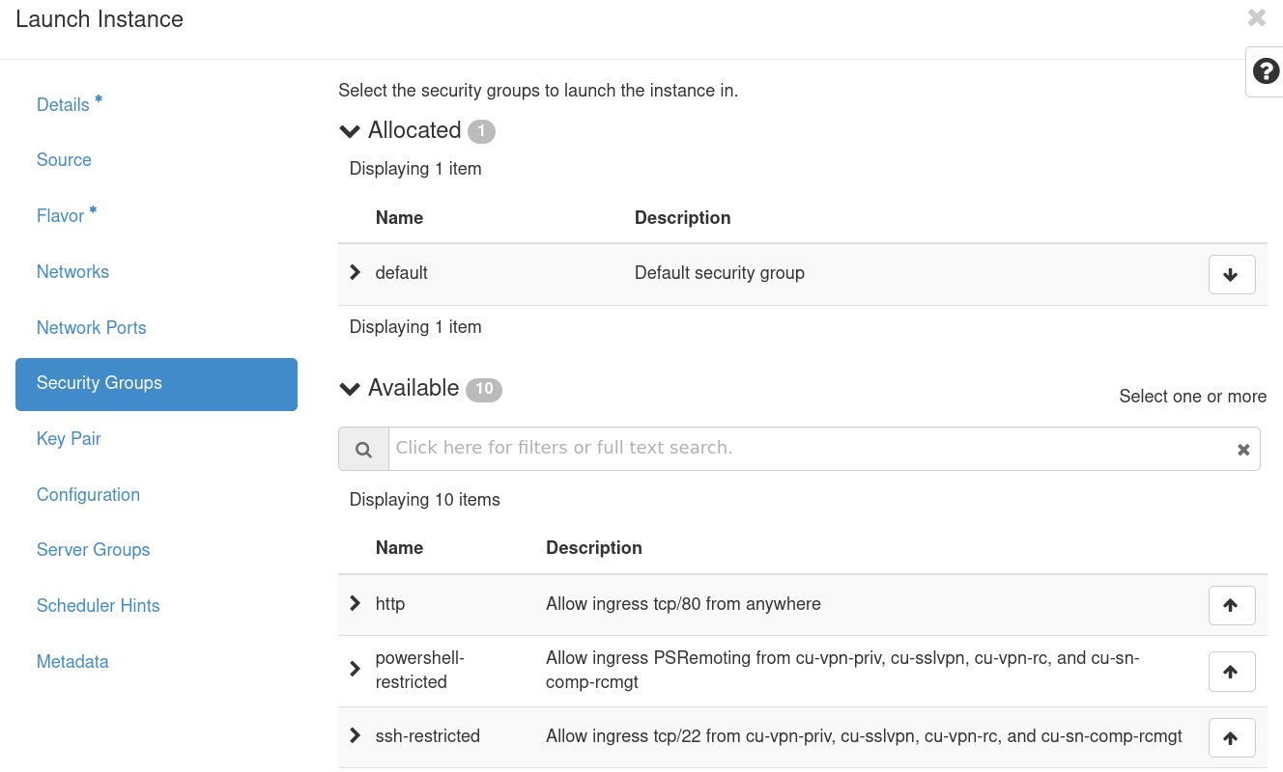
Security Groups
Security Groups act as a virtual firewall for your instance to control inbound and outbound traffic.
We’ll pick ssh-restricted, http, and https for our demo

Slide 20
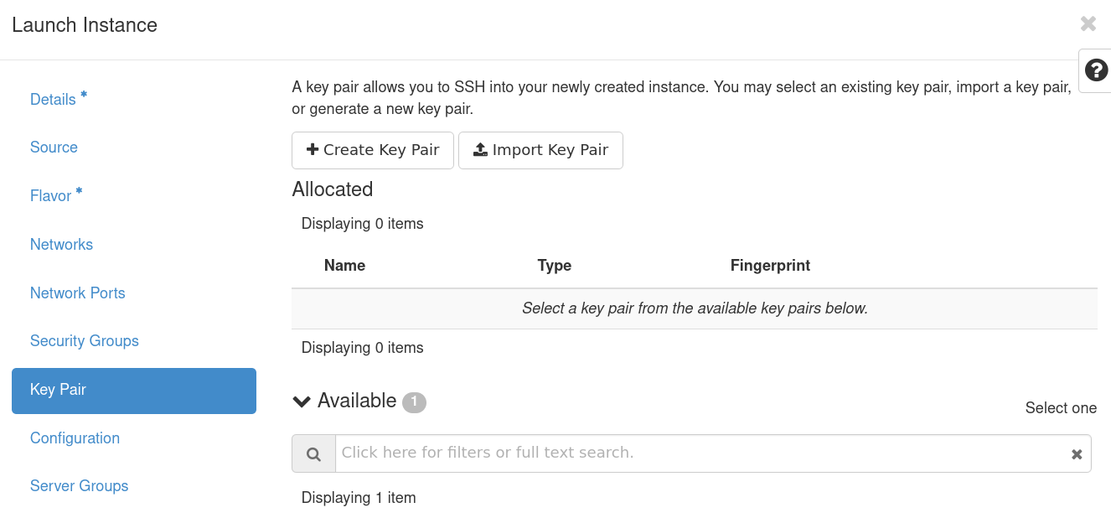
Key Pairs
A key pair allows you to SSH into your new instance.
You may select an existing key pair, import a key pair, or generate a new key pair.
I find it easiest to create a keypair on my local machine and import it
https://www.ssh.com/academy/ssh/public-key-authentication

Slide 21
Key Pairs: An aside
SSH keys are an access credential that is used in the SSH protocol and they are foundational to modern Infrastructure-as-a-Service platforms.
They can be tricky to set up for new users however, so we'll go over a simple example here. From your terminal in a local machine use the ssh-keygen command to create a new ssh keypair:
$ ssh-keygen -t ed25519
Generating public/private ed25519 key pair.
Enter file in which to save the key (/home/username/.ssh/id_ed25519):
Our new keypairs have been created at /home/username/.ssh/ and are called id_ed25519 and id_ed25519.pub. The public key (.pub) can be transferred to other remote servers (this is the key we will import to our CUmulus instance) but the private key (no suffix) should never leave the host machine.

Slide 22
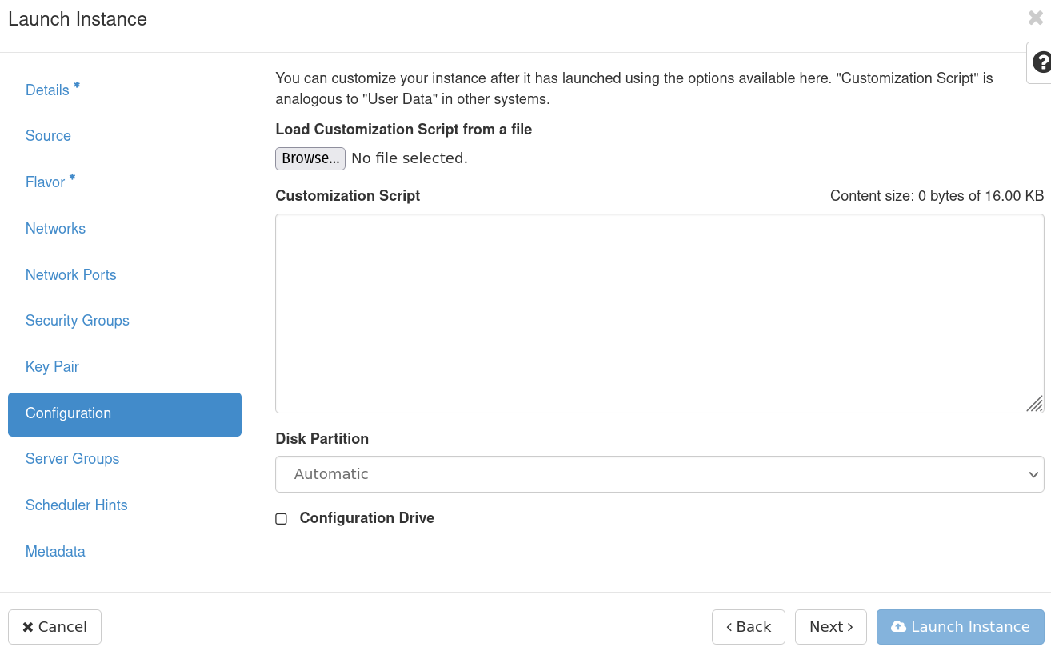
Config, Server Group, Scheduler Hints, and Metadata
We’ll leave these as defaults as they are extra configuration we can provide our instances, but not necessary

Slide 23
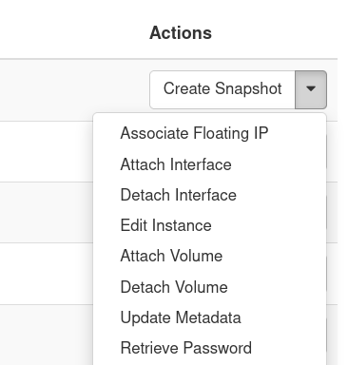
Launch Instance and Associate IP
Launch instance and wait for it to be set up
We can then associate a Floating IP which will allow us to access the instance from outside of the CU network
On the right hand side of the newly created instance choose “Associate Floating IP” under the “actions” dropdown

Slide 24
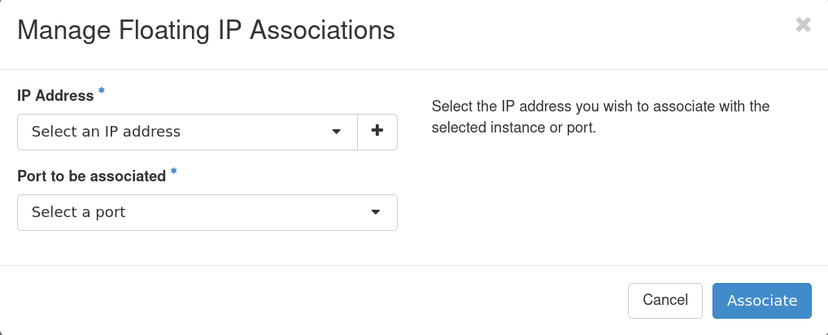
Associate IP
Select from available IP addresses
If needed you can add a floating IP, but be aware there are limited numbers of floating IPs
Select port to be associated
This should be pre-populated with the internal IP of your new instance

Slide 25
Logging into your Instance

Slide 26
Logging In
You must be on CU VPN to connect via ssh (CURC restriction)
Open up an ssh connection providing the identity (key) file:
$ ssh -i ~/.ssh/<private key> <hostname>@<external floating IP>
For an ubuntu instance this may look something like:
$ ssh -i ~/.ssh/testkey ubuntu@123.456.789.123

Slide 27
Logged In
Congratulations! You are now logged into your instance
You can now:
Install Software
Administer your instance
Run applications and jobs

Slide 28
Demo

Slide 29
Demo workflow: Twitter API with DB
There are a (nearly) infinite number of workflows you could run on your CUmulus instance*
*As long as the workflow is related to research, personal projects are not permitted.
We’ll demo a potential workflow: a web application which allows users to query using the Twitter API and store this data persistently to a mysql database.
This demo showcases a few important features of CUmulus not possible on HPC:
A persistent workflow not limited by wall clock times
User administration of compute resources (using root privileges for applications such as Docker)
Routable floating IPs available on the Public Internet

Slide 30
Thank you!
Survey: http://tinyurl.com/curc-survey18
Contact information: rc-help@Colorado.edu

